Slide 1
Adaptive Sinusoidal Models for Speech with Applications in Speech Modifications and Audio Analysis
Ph.D. Thesis Defense Presentation George Kafentzis
20th June 2014 University of Crete & University of Rennes 1

Slide 2
Outline
Introduction
Adaptive Sinusoidal Modeling - aSM
Analysis and Synthesis of Speech using aSM
Speech Modifications
Applications
  Musical Instrument Sound Modeling
  Expressive Speech Analysis and Classification
Conclusions
Contributions
PART I
PART II
PART III

Slide 3
Outline
Introduction
Adaptive Sinusoidal Modeling - aSM
Analysis and Synthesis of Speech using aSM
Speech Modifications
Applications
  Musical Instrument Sound Modeling
  Expressive Speech Analysis and Classification
Conclusions
Contributions
PART I
PART II
PART III

Slide 4
Introduction
What is “adaptive sinusoidal modeling”?
  We know “sinusoidal modeling”
    Fitting sinusoidal parameters on a short-time signal segment
    Parameters: amplitudes, frequencies, phases
  Define useful terms
    Assumption: local stationarity
      Stationarity: signal can be locally approximated with sinusoids that have constant parameters
    Opposite term: local non-stationarity
      Non-stationarity: signal can not be locally approximated by stationary sinusoids

Slide 5
Introduction
What is “adaptive sinusoidal modeling”?
  Conventional sinusoidal models assume local stationarity
    Example: Sinusoidal or Harmonic Model [1,2]
  Signals like speech are actually non-stationary!
    How to deal with non-stationarity?
      Use non-stationary exponential basis functions!
      Another word: use adaptive basis functions [3]
  Implications in speech:
    Closer representation of the speech signal
    Very accurate parameter estimation
      Used in speech coding, speech transformations, speech synthesis, …

Slide 6
Introduction
Based on stationary sinusoidal models, speech analysis, modification, and synthesis systems have been built
  Sinusoidal Model, Harmonic + Noise Model, variants [4,5,6]
Non-sinusoidal based models
  STRAIGHT [7], TD-PSOLA [8], Phase Vocoder [9], SVLN [10], variants [11,12,13]
In this thesis, we propose analysis, modification, and synthesis system based on adaptive Sinusoidal Models
  Applications
    Audio Modeling – Musical Instrument Sounds
    Speech Classification – Emotion Recognition and Classification

Slide 7
Outline
Introduction
Adaptive Sinusoidal Modeling - aSM
Analysis and Synthesis of Speech using aSM
Speech Modifications
Applications
  Musical Instrument Sound Modeling
  Expressive Speech Analysis and Classification
Conclusions
Contributions
PART I
PART II
PART III

Slide 8
Adaptive Sinusoidal Modeling
Definition:
  : complex amplitude
  : complex adaptive basis functions
Already proposed aSMs
  Adaptive Quasi-Harmonic Model - aQHM[3]:
  Adaptive Harmonic Model - aHM[4]:
Proposed in this thesis:
  Extended adaptive Quasi-Harmonic Model (eaQHM)
  Definition:

Slide 9
extended adaptive Quasi-Harmonic Model
Major difference from other aSMs
  Includes not only phase adaptation, but also amplitude adaptation
How to estimate the parameters ?
  Least Squares minimization in time-domain
  provide a frequency correction mechanism [3]
What about ?
  These are obtained from an initialization step
  Actually, eaQHM is a refinement mechanism of any AM-FM decomposition algorithm

Slide 10
How eaQHM works: Initialization step
Preliminary analysis to obtain instantaneous parameters (amplitude, frequency, phase) for each frame
Across frames
  Linear interpolation for inst. amplitudes
  Spline interpolation for inst. frequencies
  Frequency integration for inst. phases [3]
Use these to form the adaptive basis functions!
Approximation of the signal as AM-FM sinusoids

Slide 11
How eaQHM works: Adaptation step
Estimate and use to correct frequencies in each frame
Re-estimate inst. frequencies and phases over time
Form new adaptive basis functions
Estimate new and correct frequencies again
The loop goes on…
  When to stop?
  Convergence criterion : Signal-to-Reconstruction-Error Ratio

Slide 12
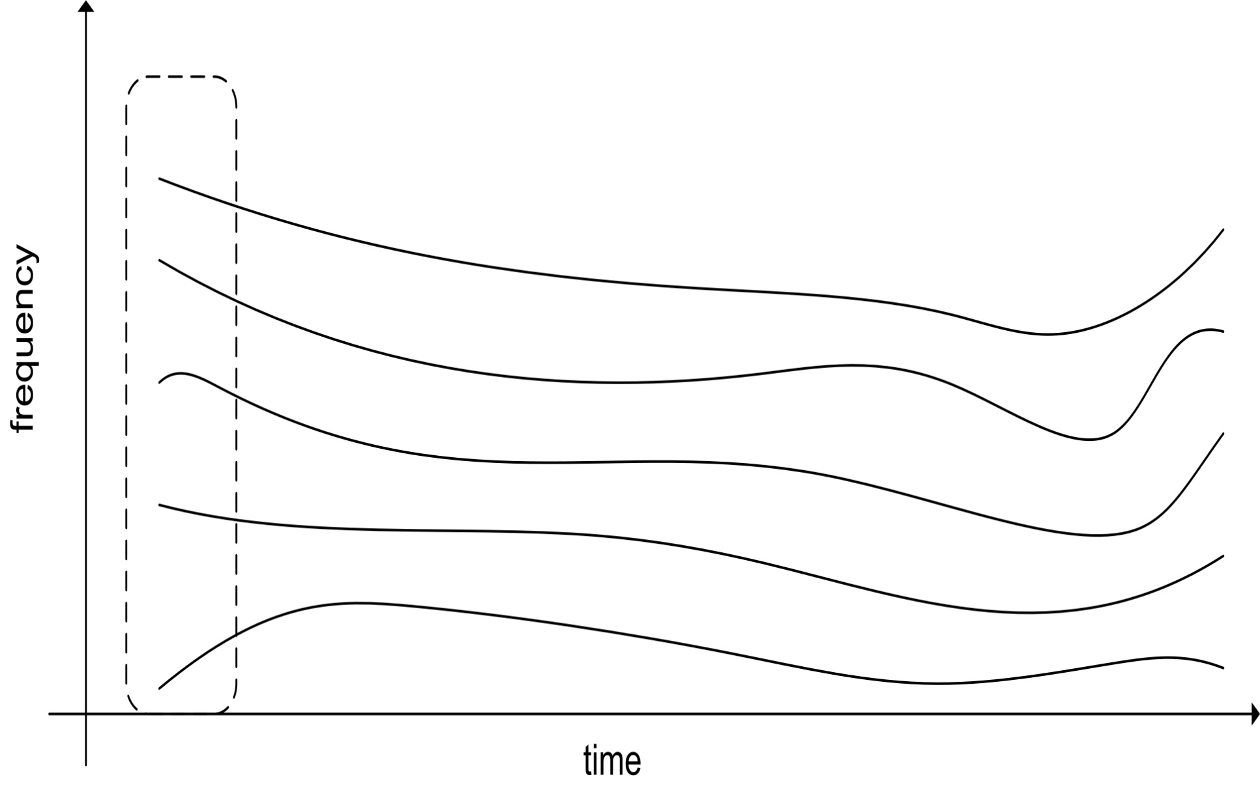
Example – Initialization

Slide 13
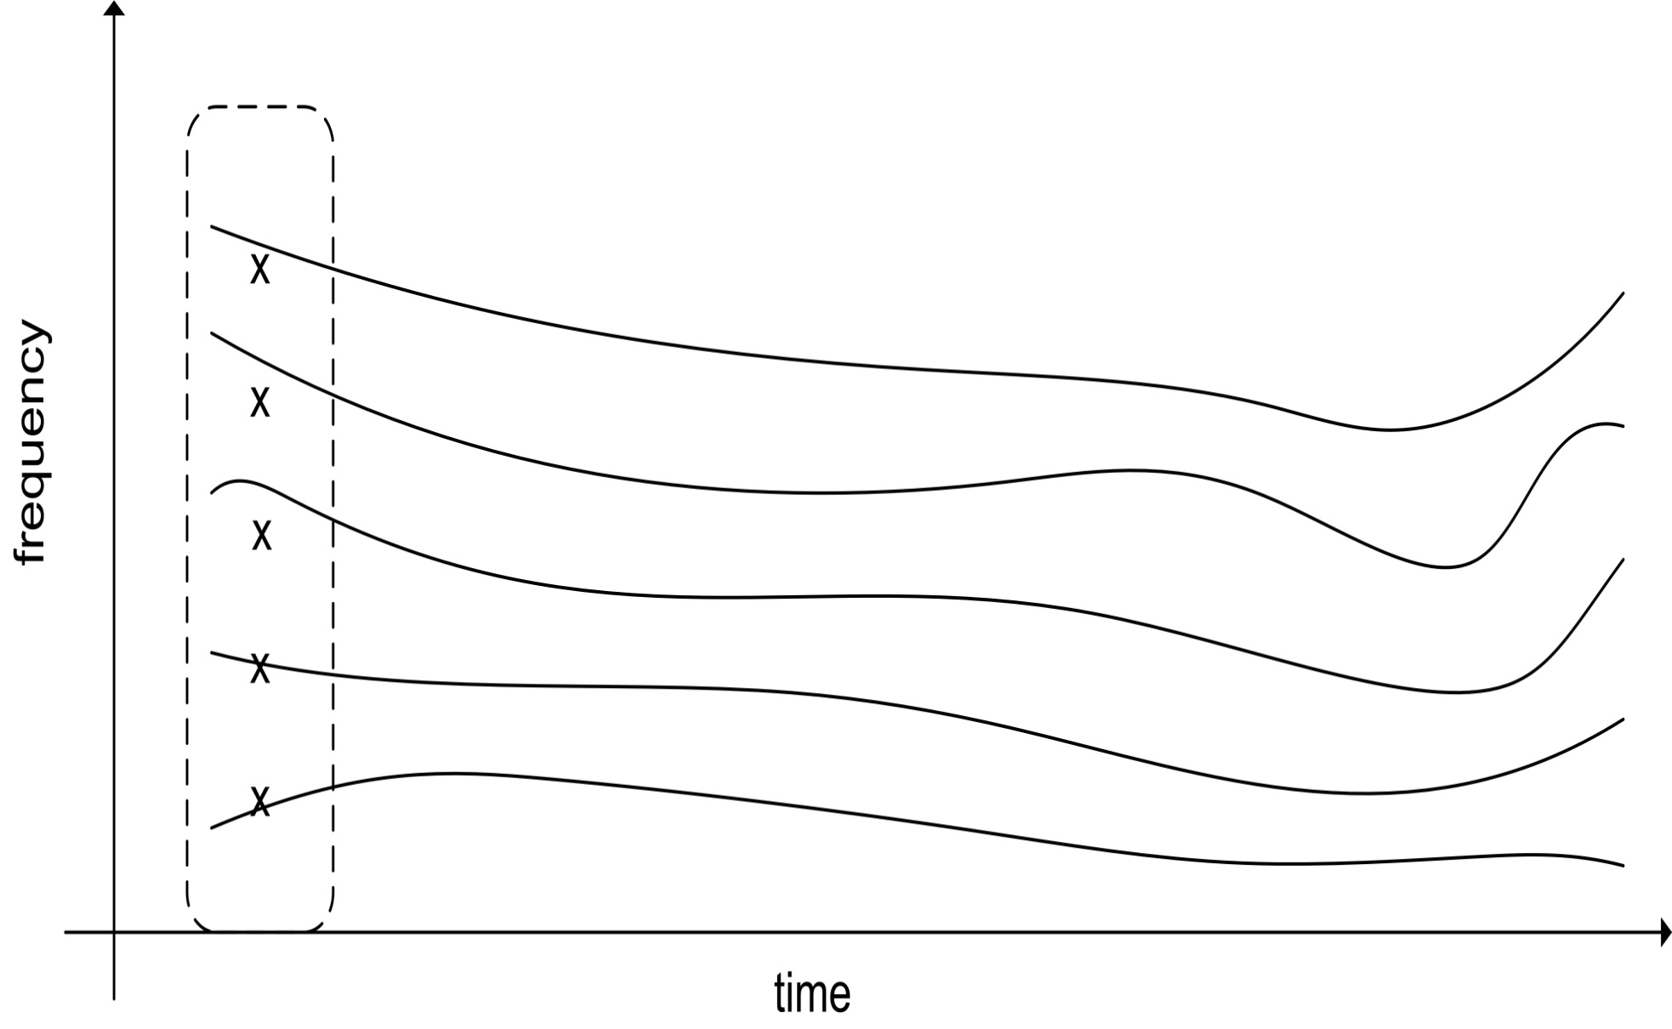
Example – Initialization
Harmonic initialization:

Slide 14
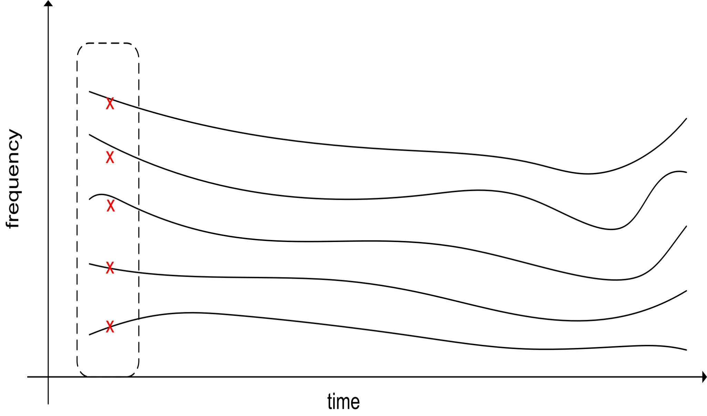
Example – Initialization
Frequency correction
Quasi-harmonic content

Slide 15
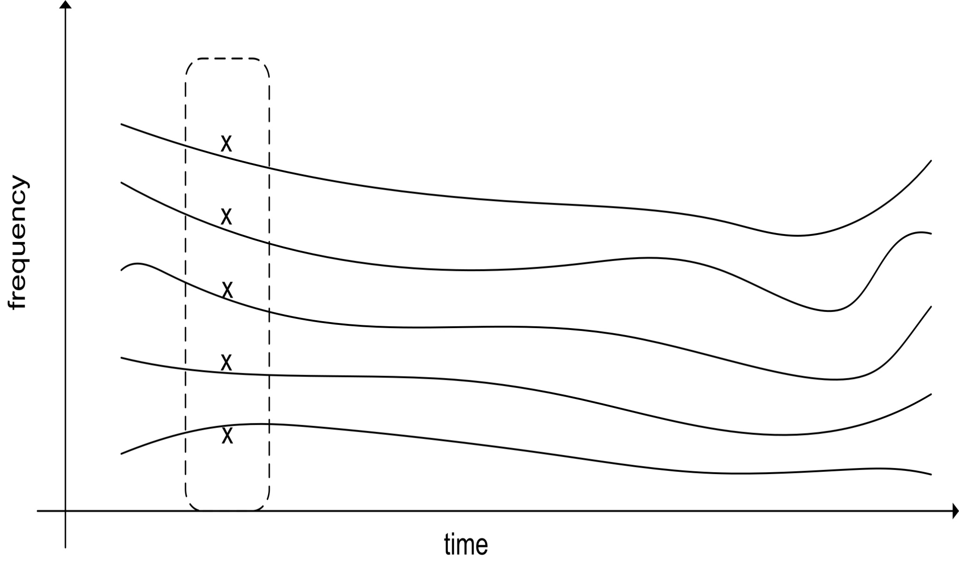
Example – Initialization
Harmonic initialization:

Slide 16
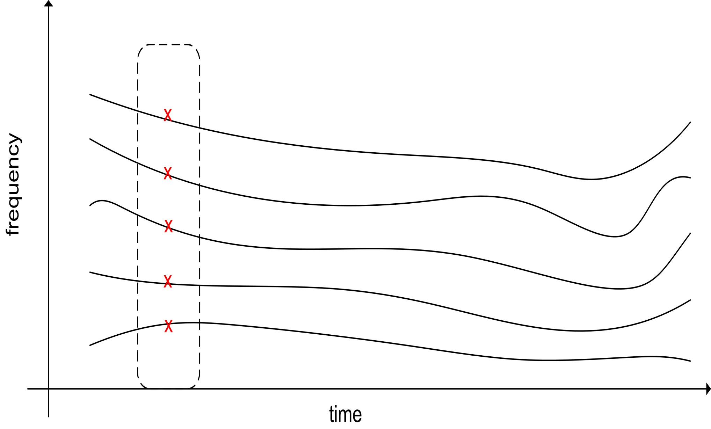
Example – Initialization
Frequency correction
Quasi-harmonic content

Slide 17
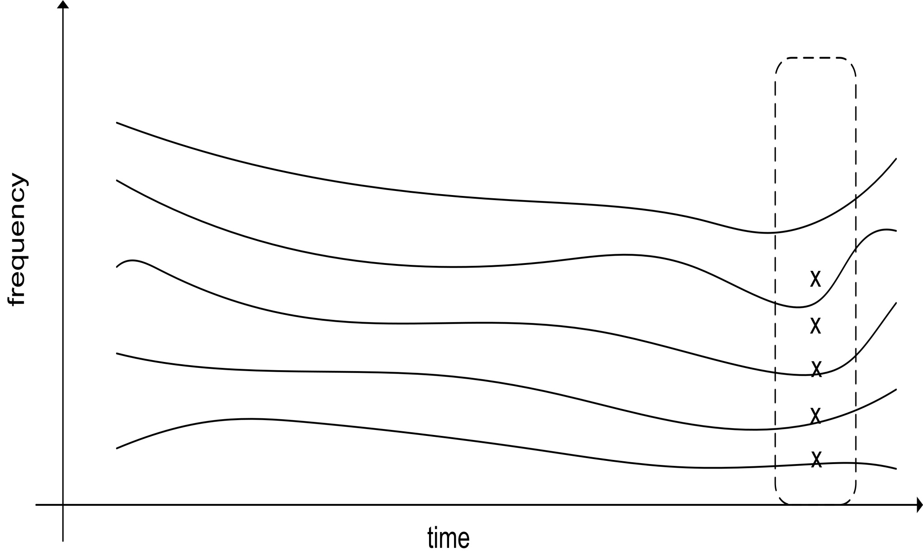
Example – Initialization
Harmonic initialization

Slide 18
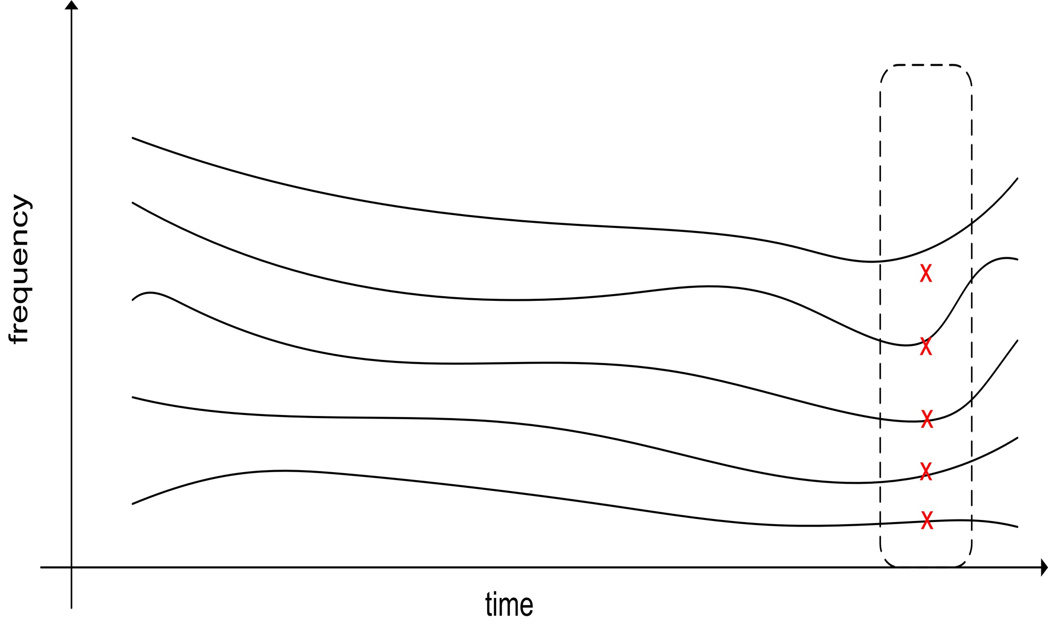
Example – Initialization
Frequency correction

Slide 19
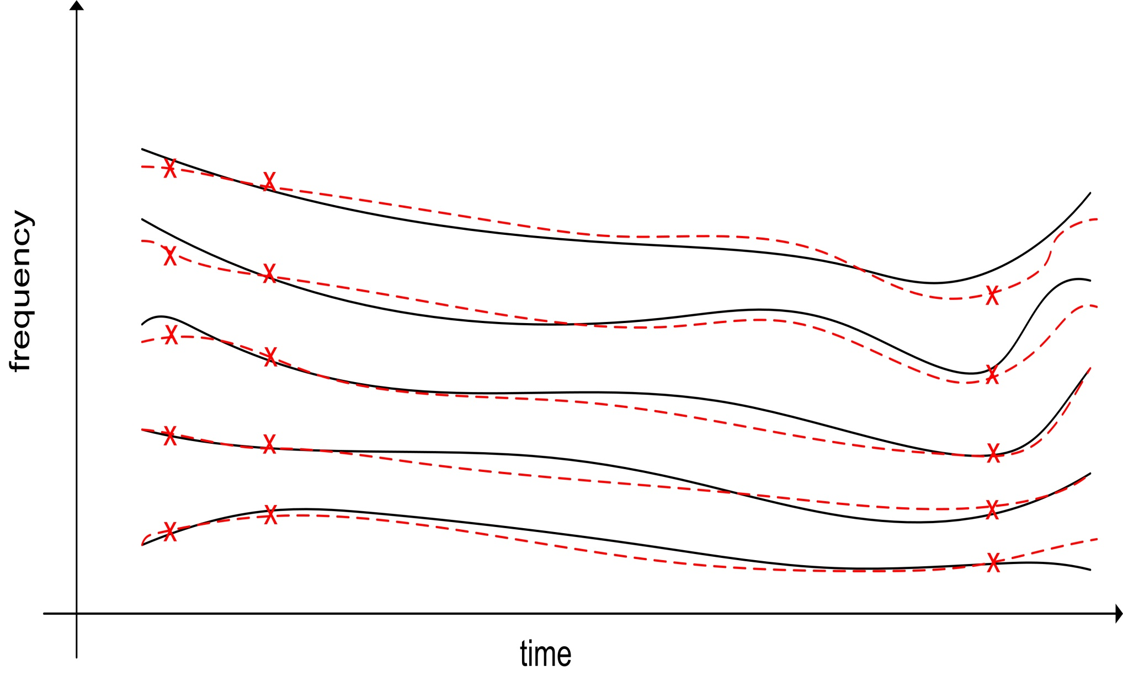
Example – Initialization : Interpolation

Slide 20
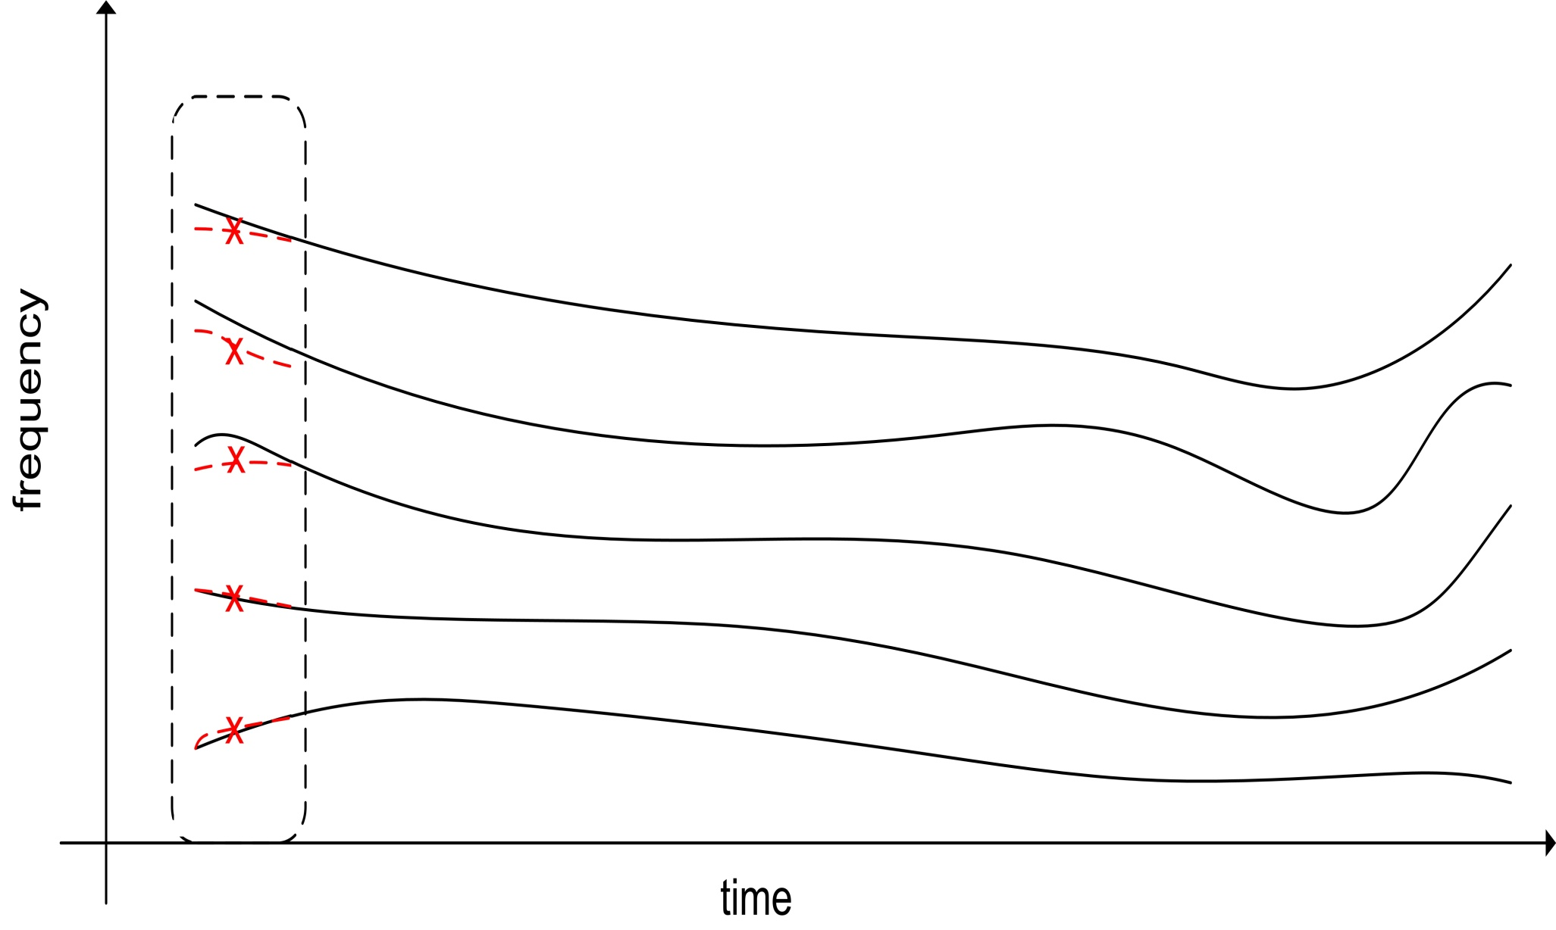
Example - Adaptation
Adaptation:

Slide 21

Example – Adaptation – Correction

Slide 22

Example - Adaptation
Adaptation:

Slide 23
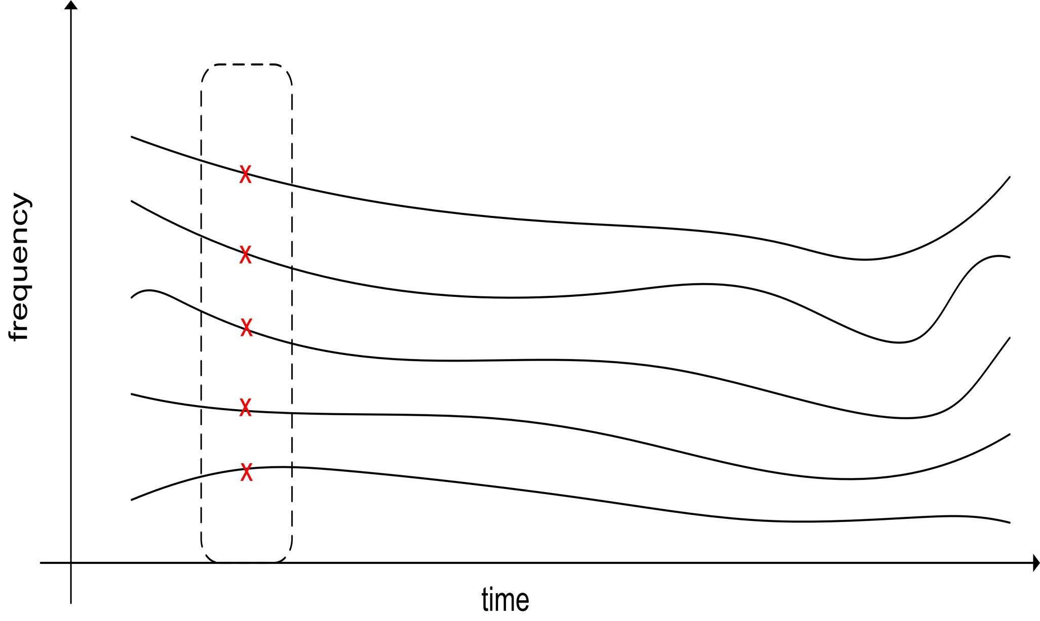
Example – Adaptation – Correction

Slide 24
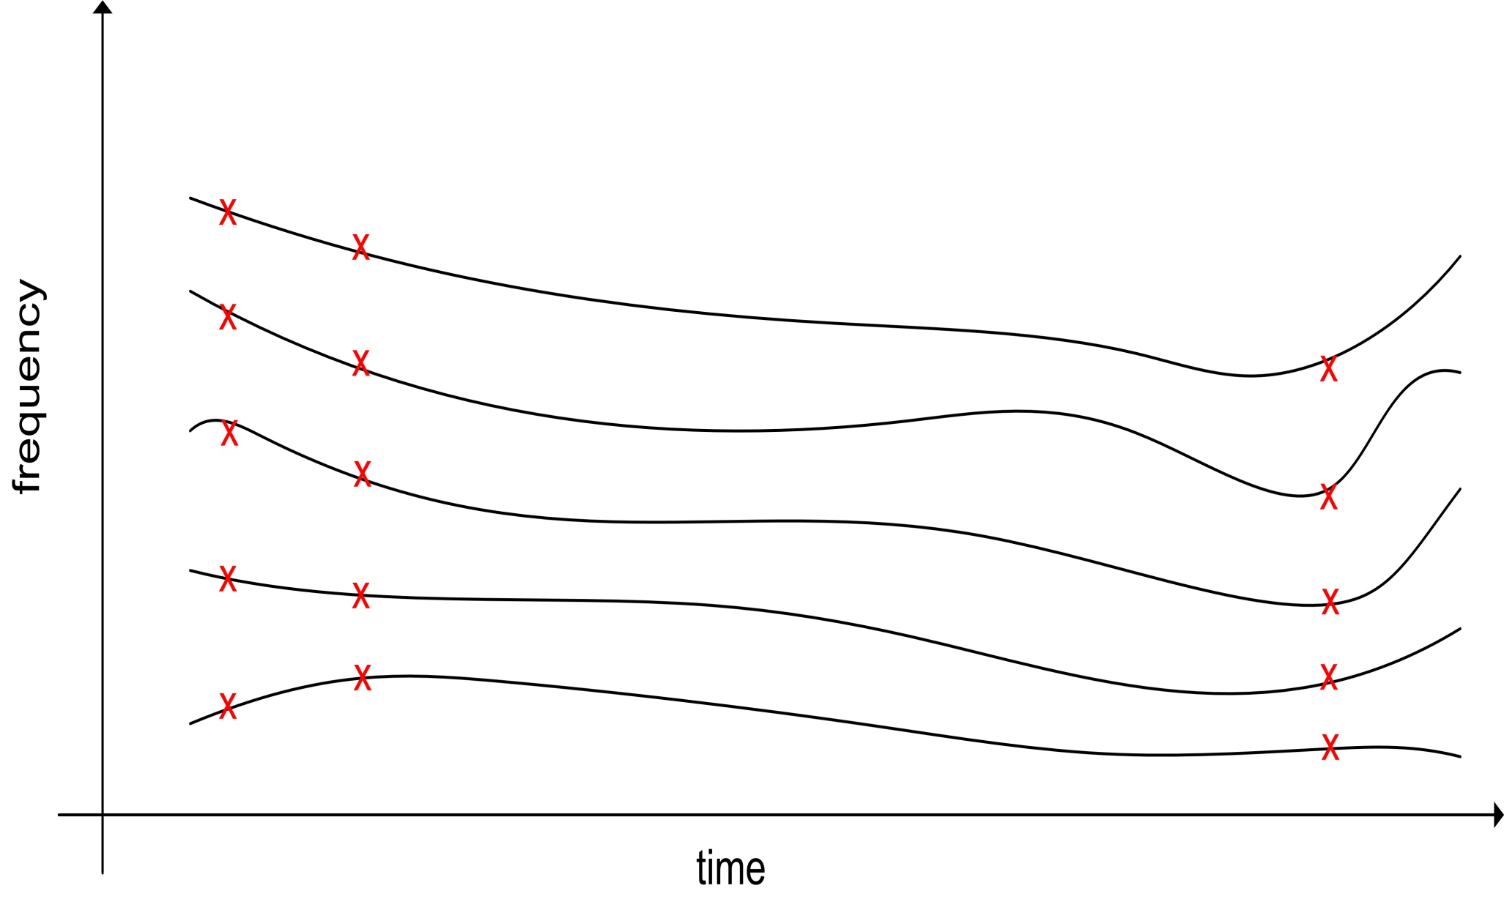
Example – Adaptation

Slide 25
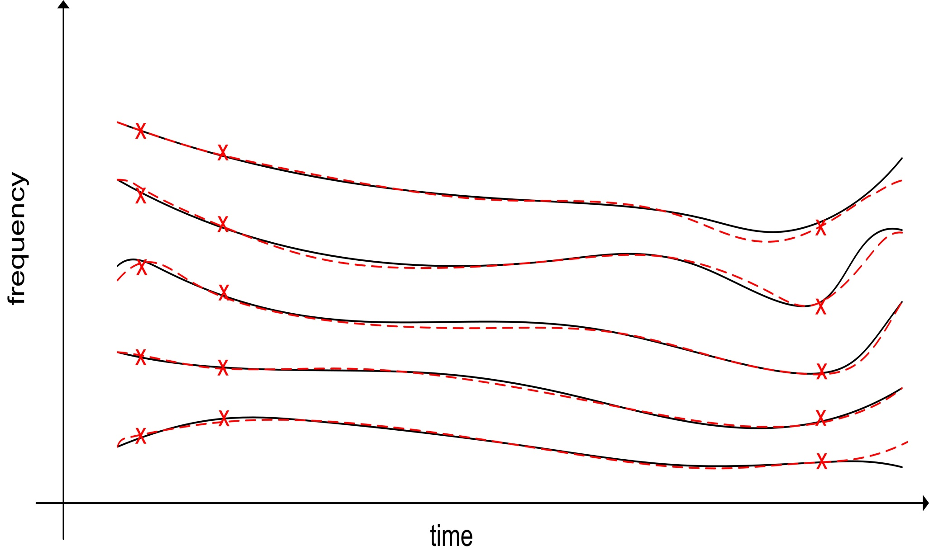
Example – Adaptation – Interpolation
…and the loop goes on…

Slide 26
extended adaptive Quasi-Harmonic Model
Signal can be estimated as an AM-FM decomposition
Validation on synthetic signal

Slide 27
extended adaptive Quasi-Harmonic Model
Validation on synthetic speech (aQHM)

Slide 28
extended adaptive Quasi-Harmonic Model
Validation on synthetic speech (eaQHM)

Slide 29
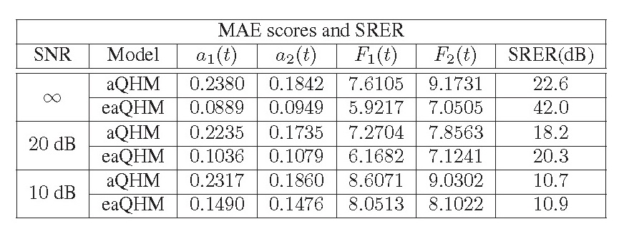
extended adaptive Quasi-Harmonic Model
Validation on synthetic speech + AWG noise
where M is the number of Monte Carlo simulations

Slide 30
extended adaptive Quasi-Harmonic Model
Validation on real speech - Example

Slide 31
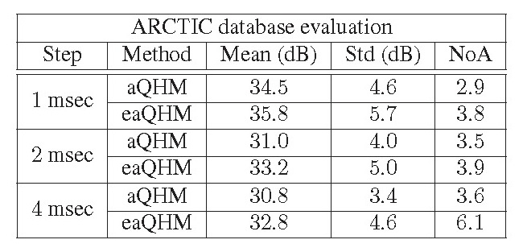
extended adaptive Quasi-Harmonic Model
Validation on real voiced speech – ARCTIC database (~50’)
where NoA is the average number of adaptations

Slide 32
Conclusions
We suggest a new adaptive Sinusoidal Model dubbed
  extended adaptive Quasi-Harmonic Model (eaQHM)
    Iterative scheme for accurate AM-FM decomposition
    Fully adaptive
    Successive correction of inst. parameters
    Tackles non-stationarity in amplitude and frequency
Validated on synthetic signals
  Noise robustness has also been validated
Validated on real voiced speech (ARCTIC)

Slide 33
Outline
Introduction
Adaptive Sinusoidal Modeling - aSM
Analysis and Synthesis of Speech using aSM
Speech Modifications
Applications
  Musical Instrument Sound Modeling
  Expressive Speech Analysis and Classification
Conclusions
Contributions
PART I
PART II
PART III

Slide 34
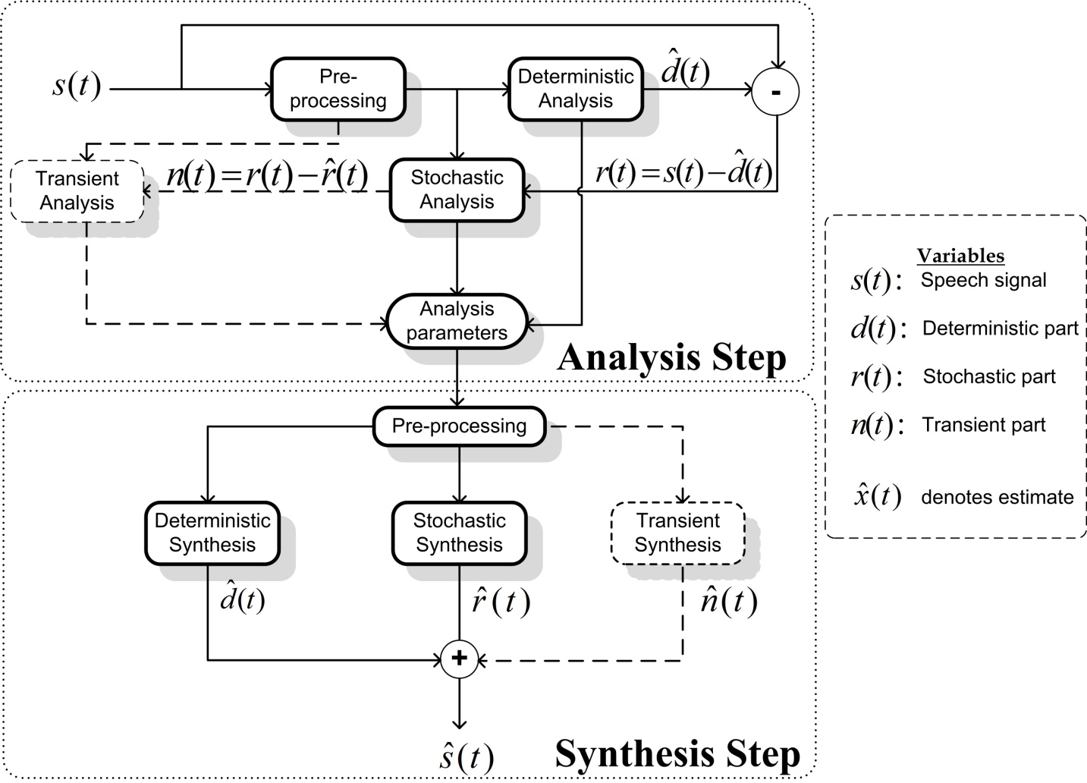
Analysis and Synthesis of Speech using aSM
Most state of the art systems utilize two (or more) components for speech analysis hybrid systems

Slide 35
Analysis and Synthesis of Speech using aSM
An eaQHM + Noise Model (eaQHNM)
  Deterministic part is modeled by eaQHM up to certain frequency
  Stochastic part is modeled as time and frequency modulated noise
Initial estimation by SWIPE pitch estimator [10]
Simple Voiced-Unvoiced frame separation [3]

Slide 36
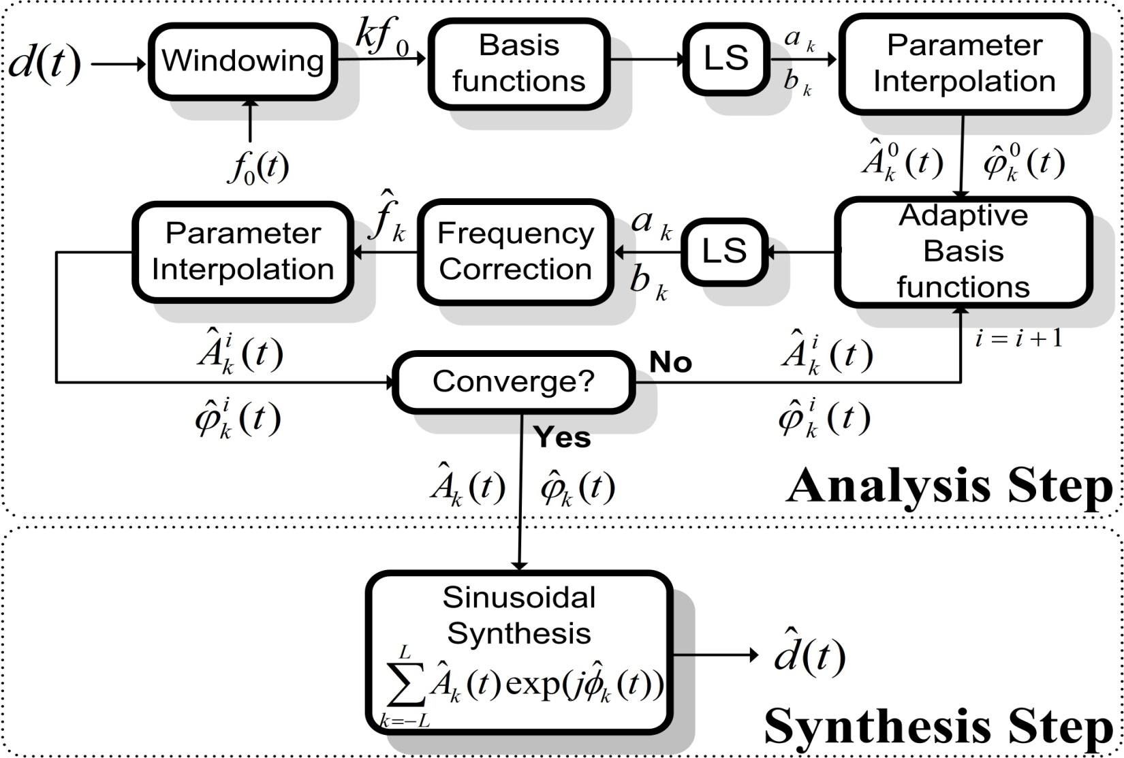
Analysis and Synthesis of Speech using eaQHM
Deterministic Part

Slide 37
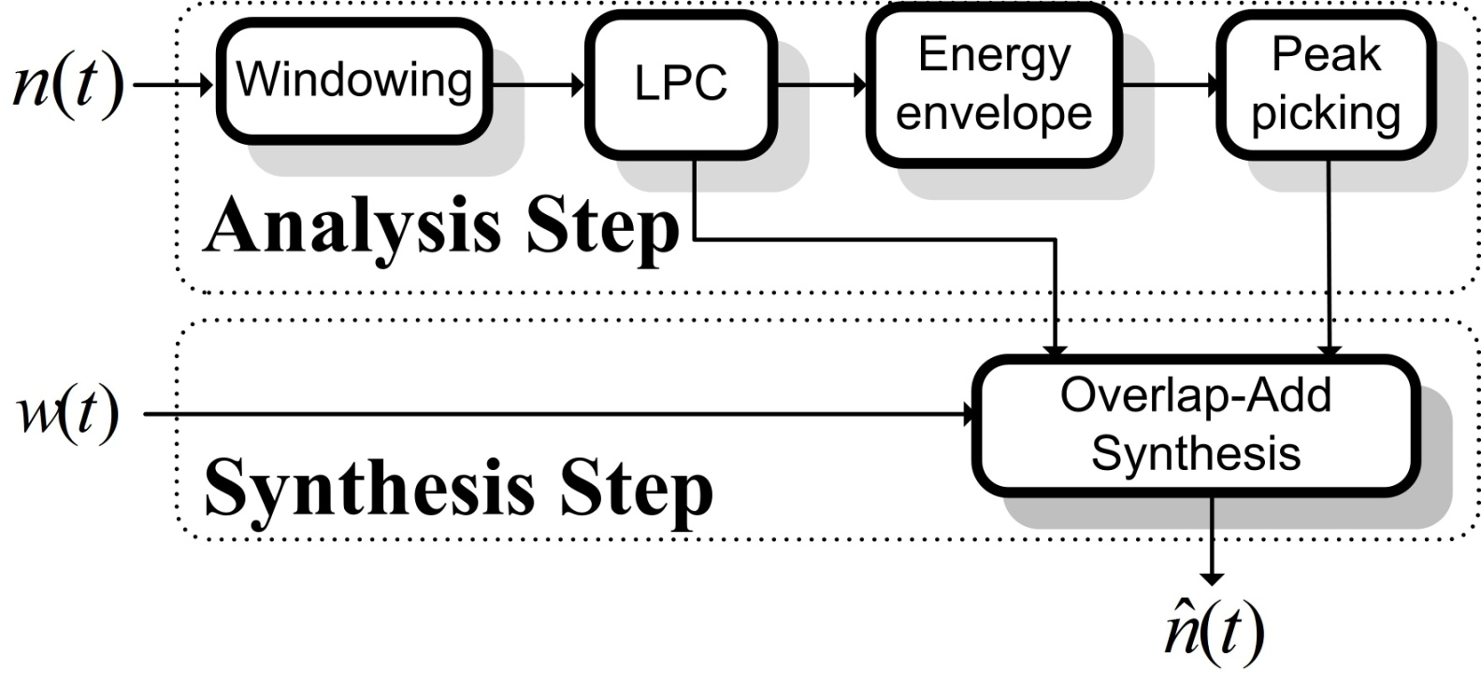
Analysis and Synthesis of Speech using eaQHM
Stochastic Part
Output signal is the sum of two parts

Slide 38
From hybrid to full-band systems
Hybrid systems work well but
  Component separation can be tricky
  Usually include a Maximum Voiced Frequency (MVF)
    It is of questionable nature and difficult to accurately estimate
  Transient frames have degraded quality
    Where to put? Deterministic or stochastic part?
  Modulated noise does not attain the quality of the original sound

Slide 39
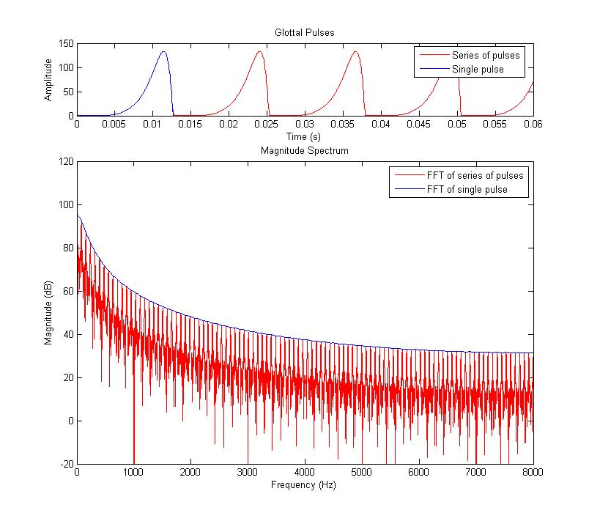
Motivation for full-band approach - I

Slide 40
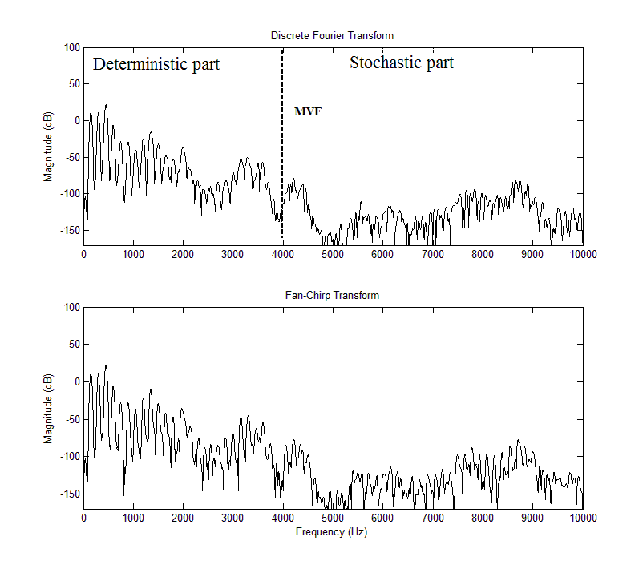
Motivation for full-band approach - II

Slide 41
Motivation for full-band approach
Idea:
  Go up to Nyquist frequency on voiced speech using sinusoids
  Transient and unvoiced frames modeled as AM-FM sinusoids
Unvoiced consonants
  Fricatives
  Voiceless stop sounds
Can we accurately represent them using high resolution AM-FM sinusoids?
  Frequency correction mechanism can fine-tune initial selection of spectral peaks
  Highest energy peaks are selected “optimal” representation

Slide 42
Stop sounds
Conventional methods introduce artifacts (pre-echo)
Need smaller analysis window size
  and an algorithm to detect such sounds
Frequencies span the whole spectrum ( Hz)
  Standard window size (3 x )
  Adaptation and frequency correction will “optimize” selection
  No frequency matching
  Birth-death of components is minimized

Slide 43
Stop sounds
  Voiceless stop sound example: ( /t/ )

Slide 44
Stop sounds – Validation
Local and Global SRER

Slide 45
Stop sounds – Validation
Global SRER

Slide 46
Fricative sounds
Fricative sound example: /s/

Slide 47
Fricative sounds – Validation
Global SRER

Slide 48
Full-band eaQHM
Full-band eaQHM represents all parts of speech
  No need for V/UV detection
  Simplified representation
Differences from hybrid eaQHM (and other models)
  Initialization: harmonic representation
    Increases robustness
    Decreases complexity
  Frequency correction adaptation number:
  Frequency matching is trivial
  Birth-death happens only in high frequencies
  Stochastic parts are well represented

Slide 49
Full-band eaQHM

Slide 50
Full-band aHM
adaptive Harmonic Model [4]
  Recently proposed adaptive model by Degottex
  Utilizes quasi-harmonic analysis to estimate parameters
  Reduces in harmonic synthesis
  Dedicated algorithm for a very accurate estimation
    called Adaptive Iterative Refinement of - AIR
      Uses to iteratively re-estimate fundamental frequency
  Very good quality of speech resynthesis

Slide 51
Evaluations
Full-band models
  SM, eaQHM, aHM
    are evaluated
      Objectively (SRER values)
      Subjectively (listening tests)
Hybrid models
  HNM
  STRAIGHT
  eaQHNM
  aHNM
    have only subjective evaluation (listening test)

Slide 52
Objective Evaluation
Two different pitch estimators (SWIPE, YIN)
  Robustness against variation
32 speakers (16 different languages, 2 genders each)
SRER values

Slide 53
Subjective Evaluation
All models
  SWIPE pitch estimation
  34 participants

Slide 54

Samples
Original | SM | HNM | STRAIGHT | aHM | eaQHM

Slide 55
Outline
Introduction
Adaptive Sinusoidal Modeling - aSM
Analysis and Synthesis of Speech using aSM
Speech Modifications
Applications
  Musical Instrument Sound Modeling
  Expressive Speech Analysis and Classification
Conclusions
Contributions
PART I
PART II
PART III

Slide 56
Speech Modifications based on aSM
Definitions
  Time scaling
    Maintain the perceptual quality of the original speech signal while changing the apparent rate of articulation.
  Pitch scaling
    Change the pitch contour of the original speech signal while maintaining the apparent rate of articulation.
We developed
  Modifications based on eaQHM
  Modifications based on aHM
Concerns
  Quality (artefact-free, shape invariant, natural)
  Flexibility
  Simplicity

Slide 57
Speech Modifications based on aHM
Time Scaling
Analysis part
  Parameter estimates for each analysis instant:
  Synthesis time instants according to a time-scale factor ρ
Time-scaling part
  Interpolate:
  Phase is trickier
      Obtain the relative phase:
    Interpolate relative phase over scaled time:
    Add back the integral of time-scaled to obtain inst. phase
Synthesis part
  Plain harmonic synthesis:
  Shape invariant time-scaled waveforms

Slide 58
Speech Modifications based on aHM
Pitch Scaling
Analysis part
  Parameter estimates for each analysis instant:
  Synthesis time instants according to a pitch-scale factor β
Pitch-scaling part
  Shift frequencies to new ones:
  Estimate and sample spectral envelope around analysis time instants:
  Phase is trickier (again!)
    Obtain the relative phase:
    Interpolate relative phase over time:
    Add back the integral of pitch-scaled to obtain inst. phase
Synthesis part
  Same as in plain harmonic synthesis:
  Shape invariance holds (up to a scaling factor)

Slide 59
Speech Modifications based on eaQHM
Time Scaling
Analysis part
  Parameters per analysis time instant:
Time-scaling part
  Interpolate:
  An similar-to-aHM phase interpolation scheme will not work
    Quasi-harmonic content
  Force equal phase relationship between analysis and synthesis instants
    Relative phase delay at analysis:
    Inst. phase at synthesis:
Synthesis part
  Same as in plain synthesis:
  Shape invariant time-scaled waveforms

Slide 60
Speech Modifications based on eaQHM
Pitch Scaling
Analysis part
  Parameters per analysis time instant:
Pitch-scaling part
  Shift frequencies to new ones:
  Estimate and sample spectral envelope around analysis time instants:
  Force equal phase relationship between analysis and synthesis instants
    Phase variation in pitch scaling is equal to the variation due to time scaling
    Inst. phase at synthesis:
Synthesis part
  Same as in plain synthesis:
  Shape invariance holds (up to a scaling factor)

Slide 61
Evaluations
Time scaling
Pitch scaling
Original | WSOLA | HNM | STRAIGHT | aHM | eaQHM
Original | HNM | STRAIGHT | aHM | eaQHM

Slide 62
Conclusions
Analysis-synthesis
  Full-band aSMs provide transparent speech resynthesis quality
  Very accurate signal reconstruction
  Validated over languages and genders
Modifications
  Simple modification schemes
  Very good quality results

Slide 63
Outline
Introduction
Adaptive Sinusoidal Modeling - aSM
Analysis and Synthesis of Speech using aSM
Speech Modifications
Applications
  Musical Instrument Sound Modeling
  Expressive Speech Analysis and Classification
Conclusions
Contributions
PART I
PART II
PART III

Slide 64
Outline
Introduction
Adaptive Sinusoidal Modeling - aSM
Analysis and Synthesis of Speech using aSM
Speech Modifications
Applications
  Musical Instrument Sound Modeling
  Expressive Speech Analysis and Classification
Conclusions
Contributions
PART I
PART II
PART III

Slide 65
Musical Instrument Sound modeling
Musical Instrument Sounds
  Challenging to represent with a single model
  Characteristics:
      Attack part
      Transient part
      Stationary part
  eaQHM seems to fit well due to its adaptive properties
  Modeling comparison with
    Sinusoidal Model (SM)
      3 parameters in analysis, 3 in synthesis (per frame)
    Exponentially Damped Sinusoidal Model (EDS)
      4 parameters in analysis, 4 in synthesis (per frame)
    Reminder: eaQHM uses 4 parameters in analysis and 3 in synthesis

Slide 66
Musical Instrument Sound modeling
Database of ~90 sounds
  Brass, Woodwinds, Strings, Percussion, Popular, Keyboard
  Different fundamental frequency (C3 to C6)
Evaluation in terms of SRER
  Local SRER (around the onset)
  Global SRER (whole waveform)
Comparison over
  Adaptation number
  Number of partials
  Window size

Slide 67
Musical Instrument Sound modeling
Number of adaptations

Slide 68
Musical Instrument Sound modeling
Number of partials: example

Slide 69
Musical Instrument Sound modeling
Window size: example

Slide 70
Conclusions
The eaQHM represents well sharp onsets with attack transients and inharmonic spectra
Local and global SRER as a function of
  the number of partials
  the size of the analysis window
The eaQHM outperforms EDS and SM in average across both variations in almost all cases
Fixed window size and number of partials
  eaQHM consistently outperformed EDS by more than 10dB and SM by over 25dB in average.

Slide 71
Outline
Introduction
Adaptive Sinusoidal Modeling - aSM
Analysis and Synthesis of Speech using aSM
Speech Modifications
Applications
  Musical Instrument Sound Modeling
  Expressive Speech Analysis and Classification
Conclusions
Contributions
PART I
PART II
PART III

Slide 72
Expressive Speech Analysis – Classification
Expressive speech (ES)
  Speech style produced by an emotionally charged speaker
Analysis of ES
  Health care, emergency conditions
  Speaker-speaker recognition and classification
  Speech synthesis
Classification
  Numerous approaches
    Features
      Continuous: pitch, energy, formants
      Qualitative: voice quality
      Spectral: LPC,MFCC
    Schemes
      HMM, GMM, NN, SVM, VQ
Sinusoidal analysis parameters are less often used

Slide 73
Expressive Speech Analysis – Classification
Is expressive speech well represented by adaptive models?

Slide 74
Expressive Speech Analysis – Classification
Listening test
Expressivity can be captured by eaQHM

Slide 75
Expressive Speech Analysis – Classification
Classification scheme
  SUSAS database
    Four emotions: angry, neutral, soft, question
    ~2520 words – 630 per emotion
    70% training, 30% testing
  Instantaneous parameters as features
    10 strongest amplitude components
    10 corresponding frequencies
  128-bit VQ classification scheme
    Minimization of Average Distortion

Slide 76
Expressive Speech Analysis – Classification
Classification (Amplitudes) – (SM in parenthesis)
Classification (Frequencies) – (SM in parenthesis)

Slide 77
Expressive Speech Analysis – Classification
Classification (Amplitudes & Frequencies)
Combination – (SM in parenthesis)

Slide 78
Expressive Speech Analysis – Classification
Conclusions
  Different emotional speech styles can be effectively represented by the eaQHM.
    Validated objectively and subjectively
  A VQ classification based on eaQHM achieves higher classification scores for a subset of the SUSAS database
    Both on single-feature classification based on the sinusoidal parameters and on their combination.
  Future work can focus on different classifiers, phase parameter exploitation, and transforming neutral speech into emotional.

Slide 79
Outline
Introduction
Adaptive Sinusoidal Modeling - aSM
Analysis and Synthesis of Speech using aSM
Speech Modifications
Applications
  Musical Instrument Sound Modeling
  Expressive Speech Analysis and Classification
Conclusions
Contributions
PART I
PART II
PART III

Slide 80
Conclusions
Presented a novel model for AM-FM decomposition named eaQHM
  Able to represent non-stationary parts of speech very accurately
Presented a novel full-band analysis and synthesis system based on eaQHM
  Capable of indistinguishable analysis and resynthesis of speech
Proposed speech modifications based on the eaQHM and the recently proposed aHM
Applied the model on two different problems
  Modeling of musical instrument sounds
  Modeling and classifying emotional speech

Slide 81
Outline
Introduction
Adaptive Sinusoidal Modeling - aSM
Analysis and Synthesis of Speech using aSM
Speech Modifications
Applications
  Musical Instrument Sound Modeling
  Expressive Speech Analysis and Classification
Conclusions
Contributions
PART I
PART II
PART III

Slide 82
Contributions Ι
Caetano M., Kafentzis G. , Mouchtaris A., Stylianou Y.,
  Adaptive Sinusoidal Modeling of Musical Instrument Sounds,
      In IEEE Transactions on Acoustics, Speech, and Language Processing (TASLP), 2014, under submission.
Kafentzis G. , Pantazis Y., Rosec O., Stylianou Y.,
  An Extension of the Adaptive Quasi-Harmonic Model,
      In IEEE International Conference on Acoustics, Speech, and Signal Processing (ICASSP), 2012
Kafentzis G. , Rosec O., Stylianou Y.,
  On the Modeling of Voiceless Stop Sounds of Speech using Adaptive Quasi-Harmonic Models,
      In Conference of International Speech Communication Association (INTERSPEECH), 2012
Kafentzis G. , Degottex G., Rosec O., Stylianou Y.,
  Time-scale Modifications based on an Adaptive Harmonic Model,
      In IEEE International Conference on Acoustics, Speech, and Signal Processing (ICASSP), 2013
Caetano M., Kafentzis G. , Mouchtaris A., Stylianou Y.,
  Adaptive Sinusoidal Modeling of Percussive Musical Instrument Sounds,
      In European Signal Processing Conference (EUSIPCO), 2013

Slide 83
Contributions ΙΙ
Caetano M., Kafentzis G., Degottex G., Mouchtaris A., Stylianou Y.,
  Evaluating How Well Filtered White Noise Models the Residual from Sinusoidal Modeling of Musical Instrument Sounds,
      In Workshop on Applications of Signal Processing to Audio and Acoustics (WASPAA), 2013
Kafentzis G., Degottex G., Rosec O., Stylianou Y.,
  Pitch-scale Modifications based on an Adaptive Harmonic Model,
      In International Conference on Acoustics, Speech, and Signal Processing (ICASSP), 2014
Kafentzis, G., Rosec O., Stylianou Y.,
  Robust Full-Band Adaptive Sinusoidal Analysis and Synthesis of Speech,
      In International Conference on Acoustics, Speech, and Signal Processing (ICASSP), 2014
Kafentzis, G., Yakoumaki T., Mouchtaris A., Stylianou Y.,
  Analysis of Emotional Speech using an Adaptive Sinusoidal Model,
      In European Signal Processing Conference (EUSIPCO), 2014
Yakoumaki T., Kafentzis G., Stylianou Y.,
  Emotion Classification using adaptive Sinusoidal Modeling,
      In Conference of International Speech Communication Association (INTERSPEECH), 2014
Kafentzis G., Rosec O., Stylianou Y.,
  Adaptive Sinusoidal Analysis, Synthesis, and Modifications of Speech,
      In IEEE Transactions on Acoustics, Speech, and Language Processing (TASLP), to be submitted.

Slide 84


Slide 85


